Slide 1
2016 Summer Reading Program at the
Framingham Public Library
Entering Grade 8

Slide 2
How to Sign Up for the Summer Reading Program
Come to the Summer Reading Kickoff Giant Games Event, Saturday, June 25!
If you can’t come on June 25th, visit the Young Adult section of the main library or the McAuliffe branch library anytime after school ends
Pick up your summer reading package…
…and your books, which will be arranged by grade on a special shelf in the Young Adult area

Slide 3
What’s in the Summer Reading Package?
Bookbag
Bookmark
Pin (limited supply)
Prize slip
List of summer programs for teens

Slide 4
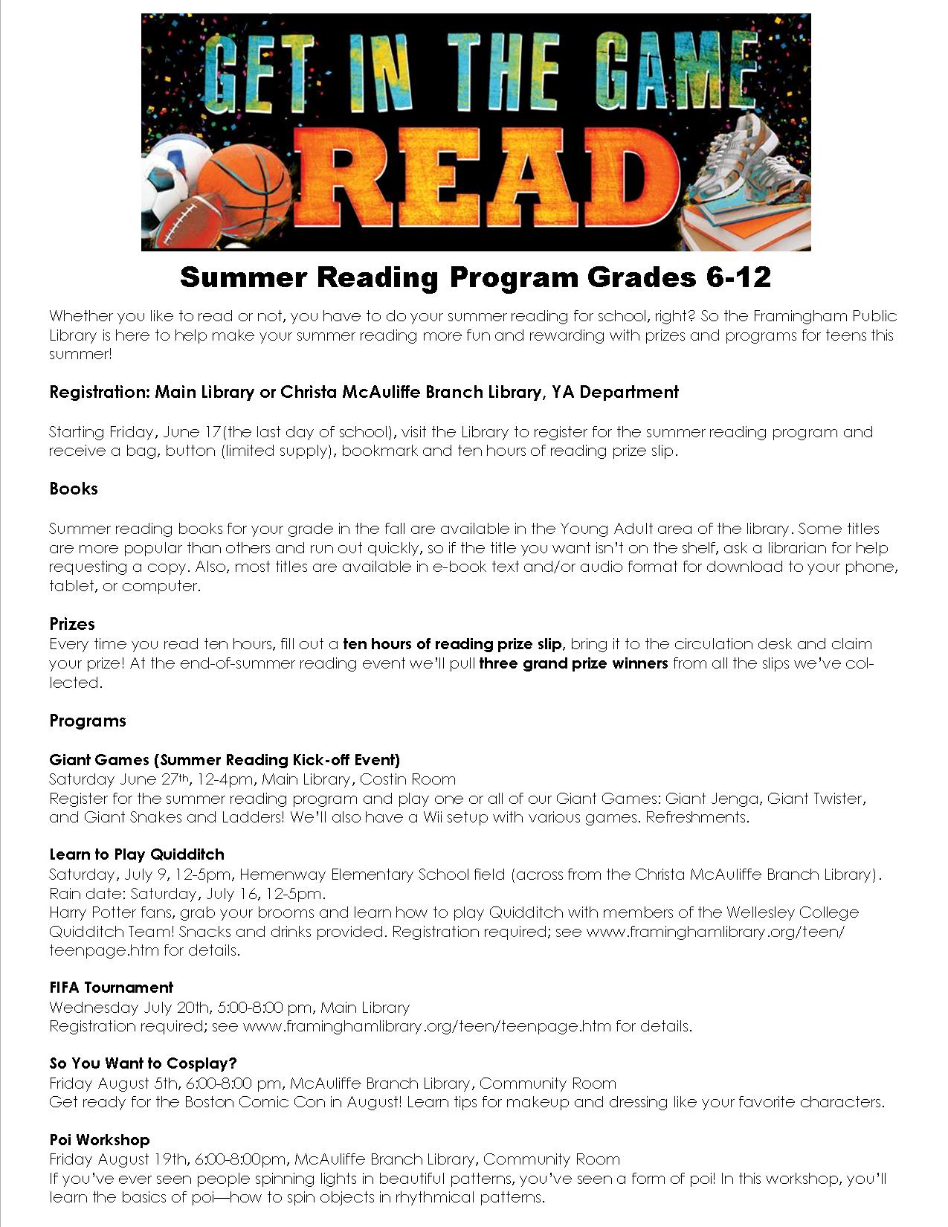
Programs and Activities for Teens

Slide 5
Getting Your Books
Special bookshelf for summer reading in Young Adult section of either the main or branch library
Request from another library
Check audiobooks (books on CD or playaway)
Check digital text and audio version of book, downloadable to tablets, smartphones, and computer – for example, iPad, Kindle, Nook, Chromebook, PC, iPhone, Android smartphone, and a lot more!
Barnes and Noble
amazon

Slide 6
The Boy on the Wooden Box, by Leon Leyson
Genre: Historical fiction
Main character: Leon
Plot summary: Leon Leyson was only ten years old when the Nazis invaded Poland and his family was forced to relocate to the Krakow ghetto. With incredible luck, perseverance, and grit, Leyson was able to survive the sadism of the Nazis, along with the help of a Nazi factory owner named Oskar Schindler.
Nazis, World War II, Jewish holocaust, survival

Slide 7
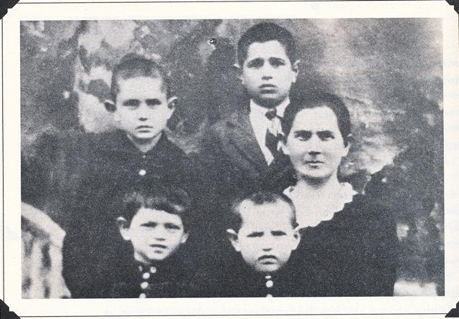
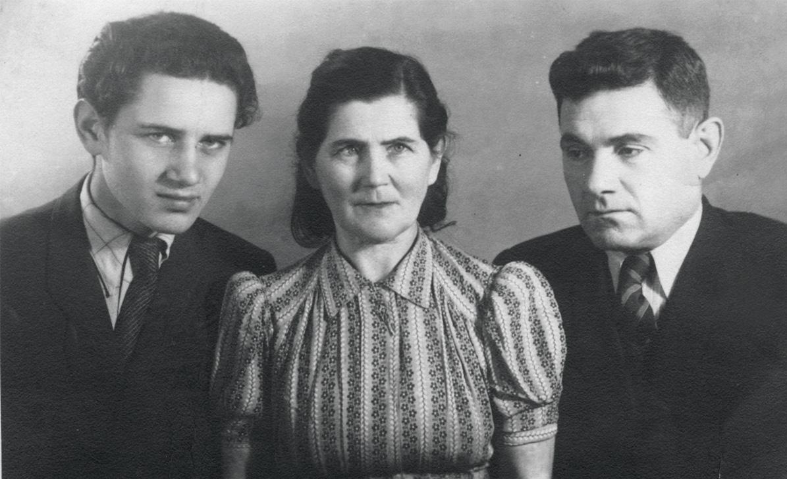
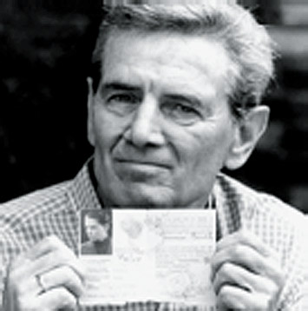
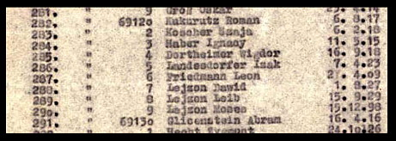
The Boy on the Wooden Box, by Leon Leyson

Slide 8
Daniel’s Story, by Carol Matas
Genre: Historical fiction
Main character: Daniel
Plot summary: Daniel, 14 in 1941, describes first his family's sense of belonging in Germany and their refusal to flee their country despite the initial instances of anti-Semitism they experience. By the time the family is ready to acknowledge the seriousness of their situation, no country is willing to accept them. They are first deported from Frankfurt to the Lodz ghetto in Poland; from Lodz they are sent to Auschwitz, and finally, Daniel and his father are marched to Buchenwald.
Nazis, World War II, Jewish holocaust, survival

Slide 9
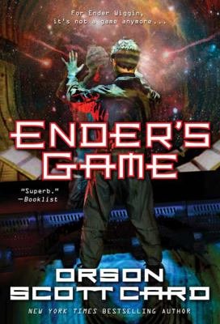
Ender’s Game, by Orson Scott Card
Genre: Science Fiction
Main Character: Andrew “Ender” Wiggin
Plot summary: In order to develop a secure defense against a hostile alien race’s next attack, government agencies breed child geniuses and train them as soldiers. Ender’s Game is the winner of the 1985 Nebula Award for Best Novel and the 1986 Hugo Award for Best Novel.
War Games, Space Warfare, Child Soldiers

Slide 10
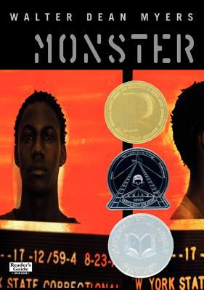
Monster, by Walter Dean Myers
Genre: Fiction, Drama
Main Character: Sixteen-year-old Steve Harmon
Setting: Somewhere in the U.S.
Plot summary: This New York Times bestselling novel and National Book Award nominee from acclaimed author Walter Dean Myers tells the story of Steve Harmon, a teenage boy in juvenile detention and on trial. Presented as a screenplay of Steve’s own imagination, and peppered with journal entries, the book shows how one single decision can change our whole lives.
Trials, Prisons, Self-perception

Slide 11
Cinder, by Marissa Meyer
Genre: Science Fiction
Main Character: Cinder and Prince Kai
Setting: New Beijing of the Eastern Commonwealth
Plot summary: As plague ravages the overcrowded Earth, observed by a ruthless lunar people, Cinder, a gifted mechanic and cyborg, becomes involved with handsome Prince Kai and must uncover secrets about her past in order to protect the world in this futuristic take on the Cinderella story.
Cyborgs, Plague, Overpopulation, Social Classes, Extraterrestrial beings

Slide 12
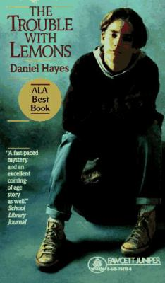
The Trouble with Lemons, by Daniel Hayes
Genre: Fiction, Mystery
Main Character: Tyler and Lymie
Setting: Somewhere in the U.S.
Plot summary: His real name was Tyler McAllister, but he felt like a lemon. He had allergies and nightmares, and was the only unfamous person in his family. But one night he and a friend went swimming at the forbidden quarry, and Tyler found a dead body. Now he’s determined to find out who killed the man and why they’re now after him…
Mystery, Detective story

Slide 13
Chomp, by Carl Hiassen
Genre: Realistic Humor
Main Character: Wahoo Crane and Tuna Gordon
Setting: Florida Everglades
Plot summary: When the difficult star of the reality television show “Expedition Survival” disappears while filming an episode in the Florida Everglades using animals from the wildfire refuge run by Wahoo Crane’s family, Wahoo and classmate Tuna Gordon set out to find him while avoiding Tuna’s gun-happy father.
Reality T.V. programs, Missing persons, Wildlife Refuges

Slide 14
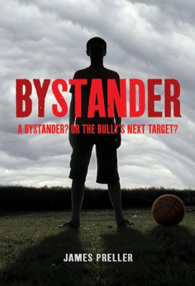
Bystander, by James Preller
Genre: Realistic Fiction
Main Character: Eric and Griffin
Setting: Long Island, NY
Plot summary: Thirteen-year-old Eric discovers there are consequences to not standing by and watching as the bully at his new school hurts people, but although school officials are aware of the problem, Eric may be the one with a solution.
Bullying, Middle Schools, Divorce, Moving Households

Slide 15
Outcasts United: The Story of a Refugee Soccer Team that Changed a Town, by Warren St. John
Genre: Nonfiction
Setting: Clarkston, Georgia
Plot summary: This is an inspirational story about the Fugees, a young soccer team made up of diverse refugees from around the world, and their formidable female coach, Luma Mufleh
Refugee children, Soccer

Slide 16
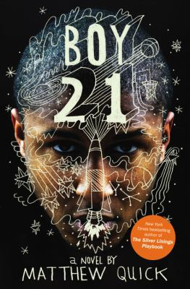
Boy 21, by Matthew Quick
Genre: Realistic fiction, basketball
Main characters: Finley, Russ (“Boy 21”)
Plot summary: Finley, the only white player on his high school's varsity basketball team, lives in a dismal Pennsylvania town that is ruled by the Irish mob, and when his coach asks him to mentor a troubled African American student who has transferred there from an elite private school in California, he finds that they have a lot in common in spite of their apparent differences.
Basketball, friendship, trauma, gangs, romance

Slide 17
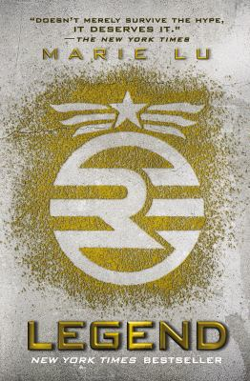
Legend, by Marie Lu
Genre: Dystopian, Hunger Games-ish
Main Characters: Day, June
Plot summary: North America has split into two warring nations – the Republic and the Colonies. Fifteen-year-old Day, a famous criminal, and prodigy June, the brilliant soldier hired to capture him, discover that they have a common enemy.
If you liked The Hunger Games, dystopia, action and adventure

Slide 18
Tokyo Heist, by Diana Renn
Genre: Mystery
Main Character: Violet Rossi, 16
Setting: Seattle, Tokyo, today
Plot summary: When Violet agrees to spend the summer with her father, an up-and-coming artist in Seattle, she learns that her father's newest clients, the Yamada family, are the victims of a high-profile art robbery: van Gogh sketches have been stolen from their home, and, until they can produce the corresponding painting, everyone's lives are in danger -- including Violet's and her father's.
Mystery, manga, Japan, art, art heist, romance

Slide 19
13 Little Blue Envelopes,
by Maureen Johnson
Genre: Realistic fiction
Main Characters: Ginny, Aunt Peg
Plot summary: When seventeen-year-old Ginny receives a packet of mysterious envelopes from her favorite aunt, she leaves New Jersey to criss-cross Europe on a sort of scavenger hunt that transforms her life.
Travel through Europe, scavenger hunts, mystery, romance

Slide 20
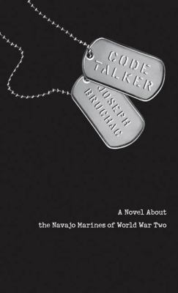
Code Talker, by Joseph Bruchac
Genre: Historical fiction
Main Character: Ned Begay, 16
Setting: Arizona and the South Pacific, during World War II
Plot summary: After being taught in a boarding school run by whites that Navajo is a useless language, Ned Begay and other Navajo men are recruited by the Marines to become Code Talkers, sending messages during World War II in their native tongue.
World War II, Navajo culture, cryptography, battles

Slide 21
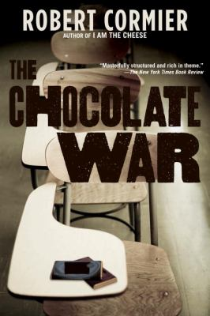
The Chocolate War, by Robert Cormier
Genre: Realistic Fiction
Main Character: Jerry Renault
Setting: An all-boys prep school
Plot summary: Jerry Renault ponders the question on the poster in his locker: Do I dare disturb the universe? Refusing to sell chocolates in the annual Trinity school fundraiser may not seem like a radical thing to do. But when Jerry challenges a secret school society called The Vigils, his defiant act turns into an all-out war.
High School, Bullying, Coming of age story

Slide 22
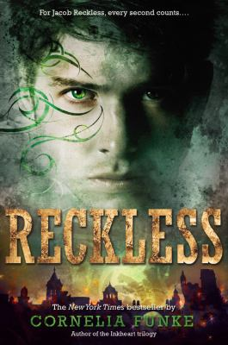
Reckless, by Cornelia Funke
Genre: Fantasy
Main Character: Brothers Jacob and Will Reckless
Setting: Fantasy world
Plot summary: Jacob and Will Reckless have looked out for each other ever since their father disappeared, but when Jacob discovers a magical mirror that transports him to a warring world populated by witches, giants and ogres, he keeps it to himself until Will follows him one day, with dire consequences.
Adventure, Brothers, Magic

Slide 23
A Separate Peace, by John Knowles
Genre: Fiction, Classic
Main Character: Gene and Phineas
Setting: Boys’ Boarding School in New Hampshire
Plot summary: An American classic and great bestseller for over thirty years, A Separate Peace is timeless in its description of adolescence during a period when the entire country was losing its innocence to the Second World War.
Friendship, Death, Prep school

